Slide 1
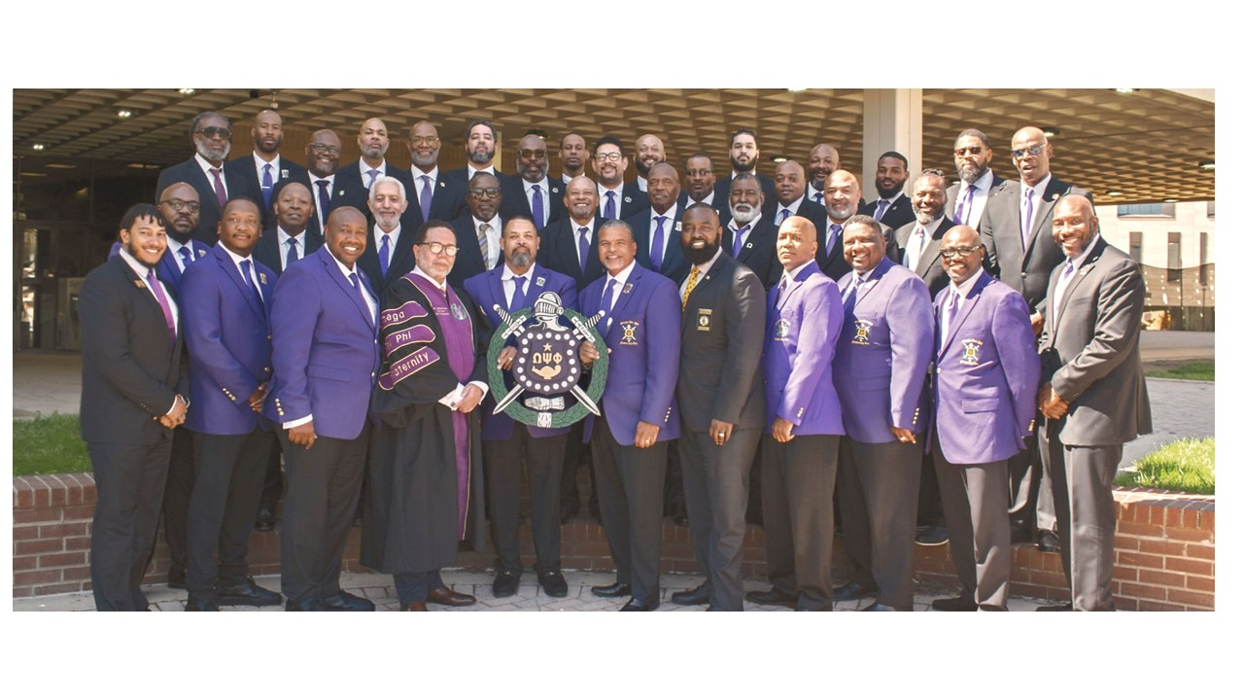
Omega Psi Phi Fraternity Inc
Credit Union Option
Phi Nu Nu Life Membership
Overview
Phi Nu Nu Chapter Bro. Dan White
Presentation Keeper of Finance

Slide 2


Omega Psi Phi Fraternity Federal
Credit Union
For more info: www.oppffcu.org
Notes:
The Omega Psi Phi Fraternity Federal Credit Union provides financial avenues for fraternity members, families and employees to save, borrow and take advantage of all the services available to you. The credit union services are provided by Peach State Federal Credit Union with oversite from the OPPFFCU Board (7) members from the fraternity.

Slide 3
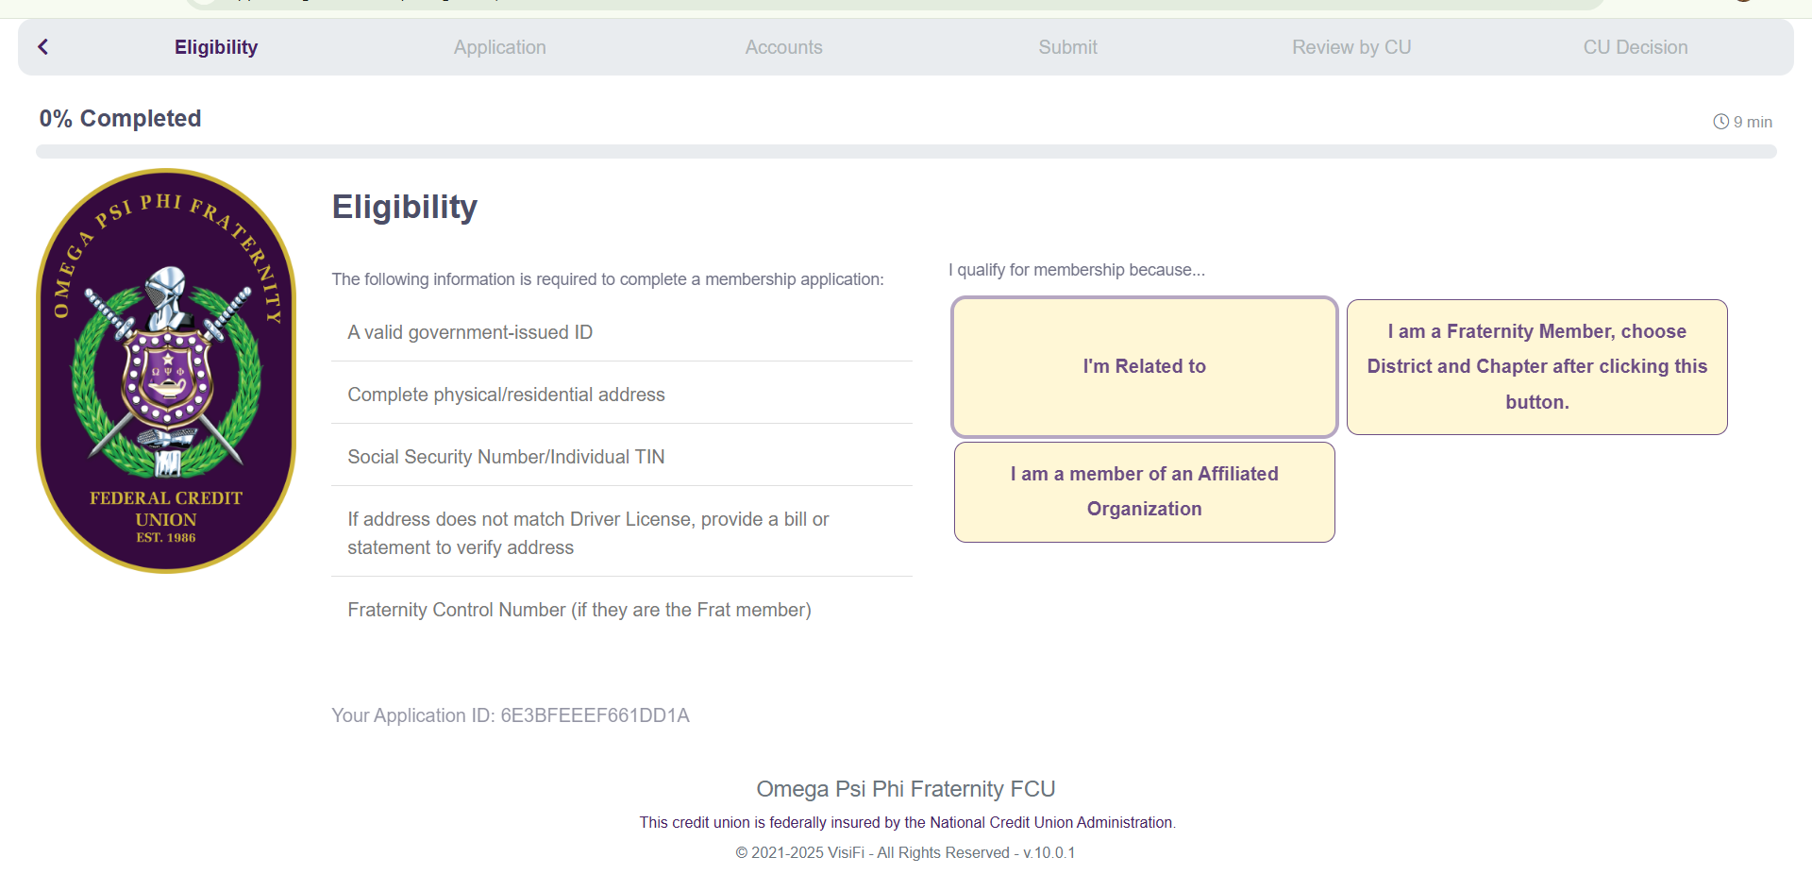
Omega Psi Phi Fraternity Federal
Credit Union Membership Eligibility
Notes:
Become a member of the Credit union complete application process and pay one time $50 membership fee.

Slide 4
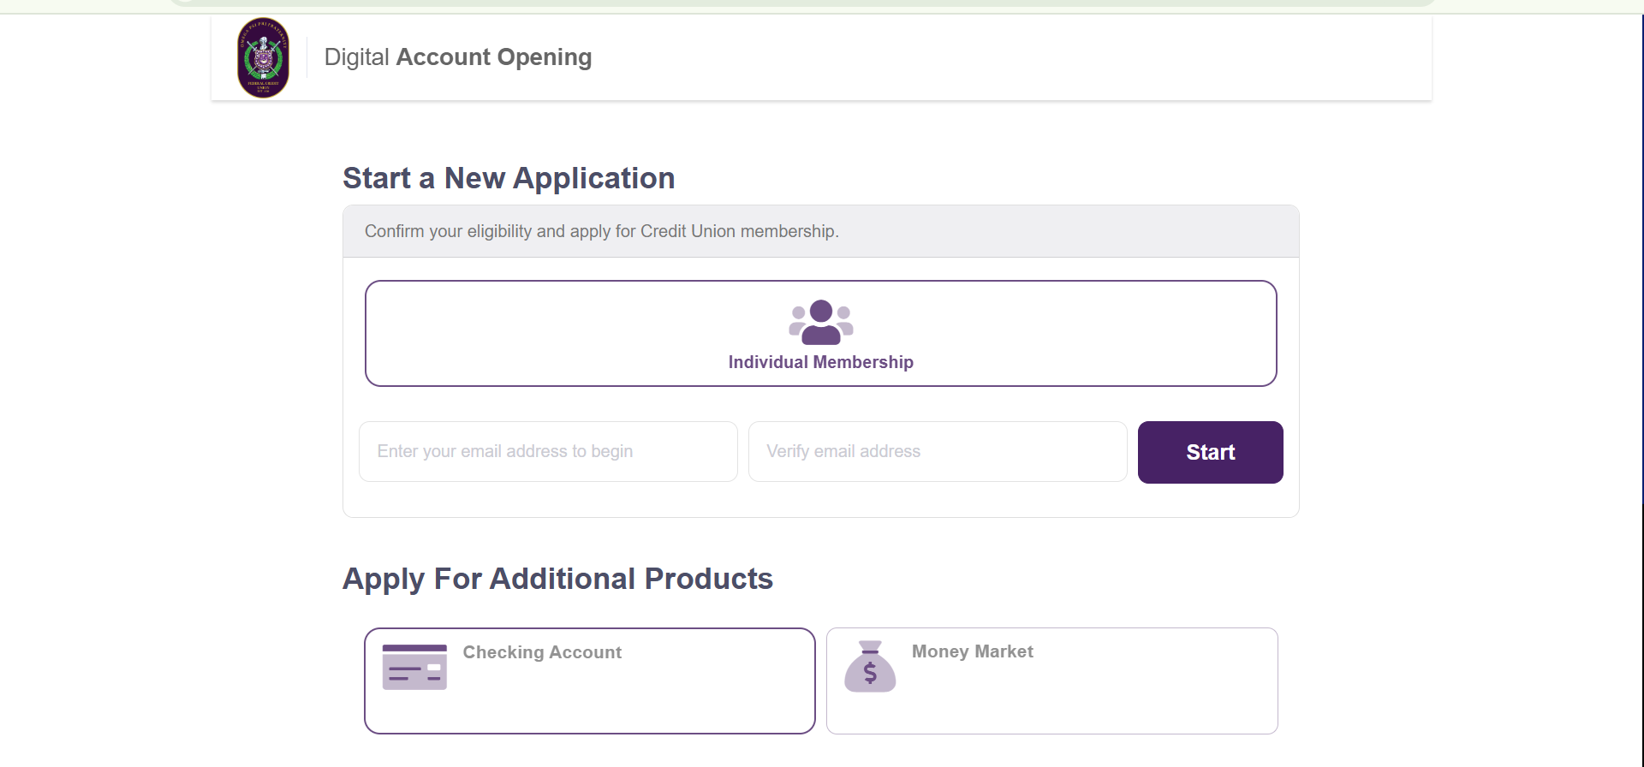
Omega Psi Phi Fraternity Federal
Credit Union
Loan
https://oppffcu.com/members/member-application/
Notes:
Bruhs can apply for a loan through OPPFFCU credit union. Must be a member of the credit union. Apply on line $50 membership fee. The credit union has a variety of terms based on individual credit profile. Loans can have loan terms of 36 months or less. Phi Nu Nu lifetime $4,750. You could be lifetime member for less than $160/month depending on your credit profile.

Slide 5
Omega Psi Phi Fraternity Federal
Credit Union
Loan
Requirements to apply for OPPFFCU Loan:
Be a member of the Credit Union (fee $50)
Complete on-line application (fee $20)
Submit required documents
OPPFCU Board completes loan review process

Slide 6
Omega Psi Phi Fraternity Federal
Credit Union
Loan
Loan Terms
Loan rate between 2-6%
Loan period 36 months or less
Set payment schedule

Slide 7
Omega Psi Phi Fraternity Federal
Credit Union
Loan
Next Steps
Receive loan funds from OPPFCU
Submit $4,750 one-time payment to Friendship First Foundation, Inc.
  Check, Credit card, Cash App, or EFT through your bank (100% tax-deductible)
Receive Lifetime membership confirmation

Slide 8
Omega Psi Phi Fraternity Federal
Credit Union
Loan examples
12 month option 24 month option 36 month option
$4,750 Phi Nu Nu $4,750 Phi Nu Nu $4,750 Phi Nu Nu
Life Membership Life Membership Life Membership
$190 (4% interest) $190 (4% interest) $190 (4% interest)
$395.58/month $197.92/month $131.94/month
No penalty for early loan pay off.

Slide 9

Omega Psi Phi Fraternity Federal
Credit Union Contact Info
Notes:
Contact information for the credit union

